Slide 1
GEOG-G489/589 Python Programming
Instructor: Natasha MacBean

Slide 2
Video Introduction
Welcome to the class!

Slide 3
What is programming? Why is it important? Why program/code in Python?
Welcome to the class!
CLICK LINK: Set of instructions (then converted into binary) that tells a computer how to perform a specific task.
CLICK LINK: Probably the most useful skillset for the 21st Century!
CLICK LINK: Open source, high-level, user-friendly language that has a large user community.
Notes:
https://www.youtube.com/watch?v=cKhVupvyhKk
https://www.youtube.com/watch?v=kK_2mzBARTU

Slide 4
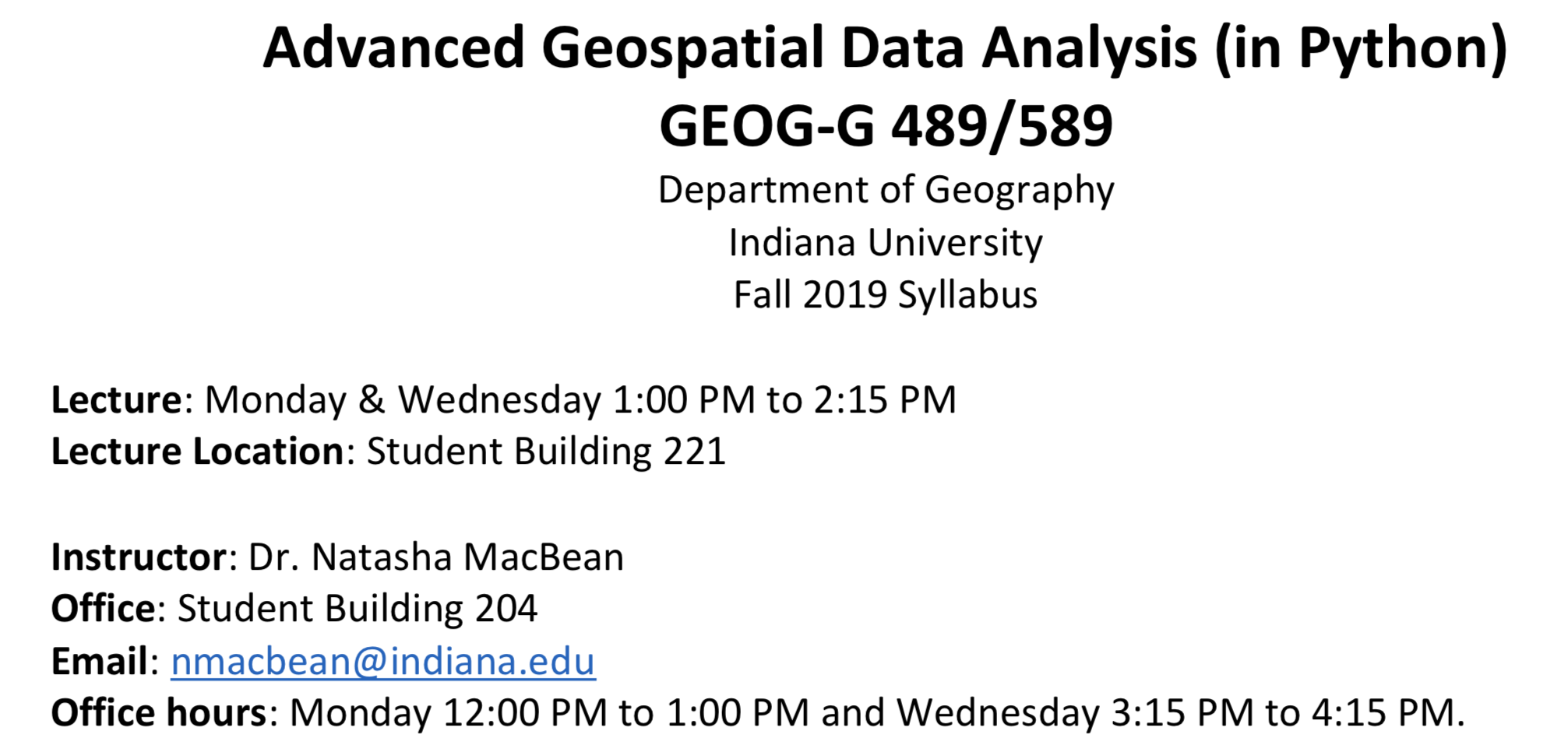
Syllabus Please through the syllabus carefully this week and email me if you have any questions

Slide 5
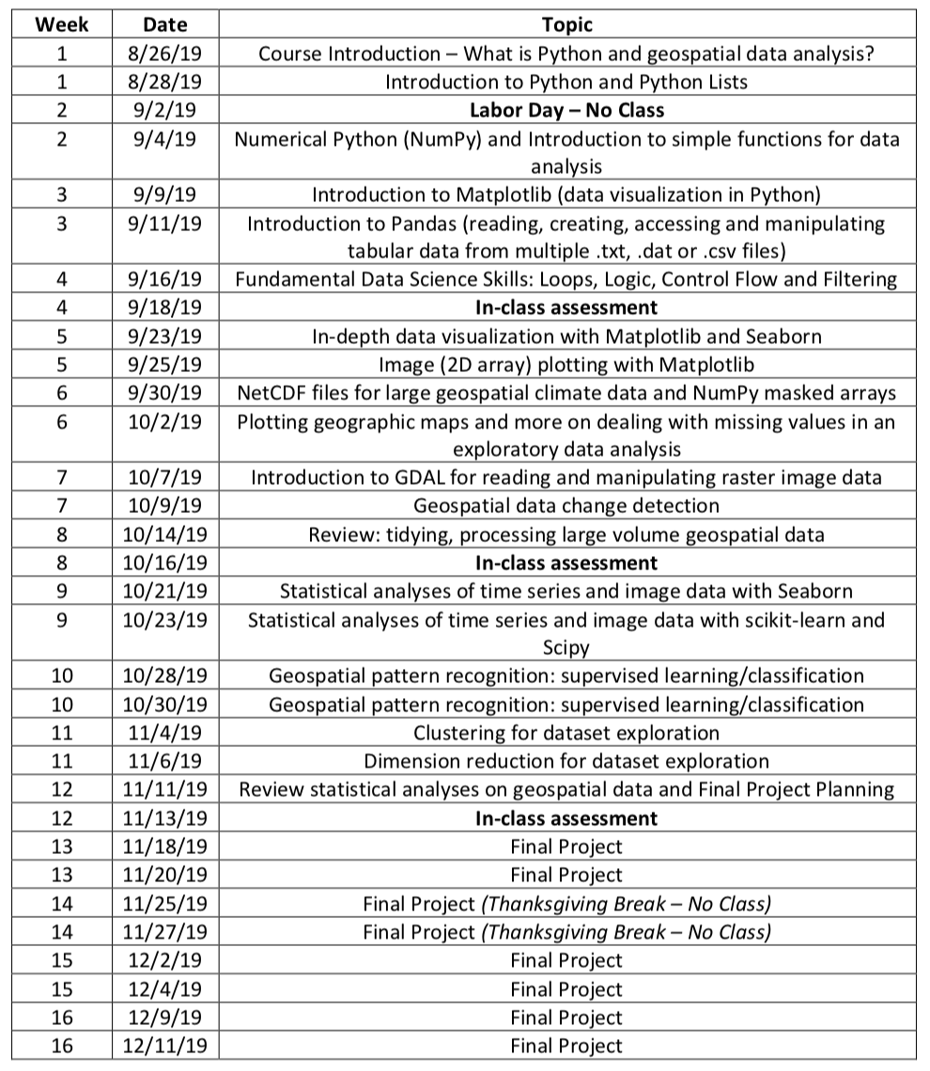
Syllabus

Slide 6
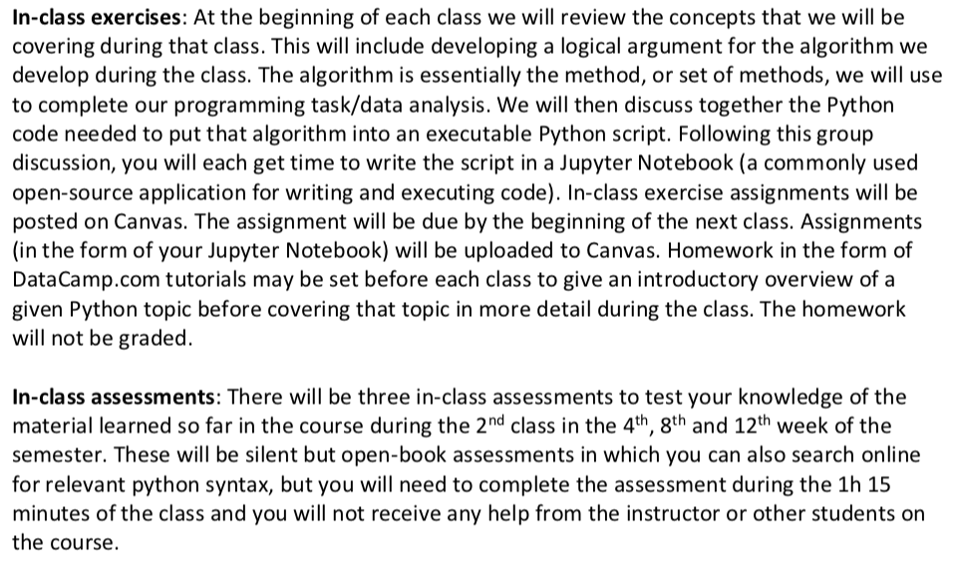
Course Format

Slide 7
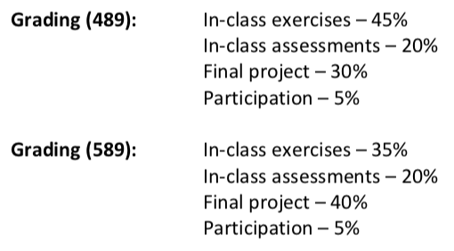
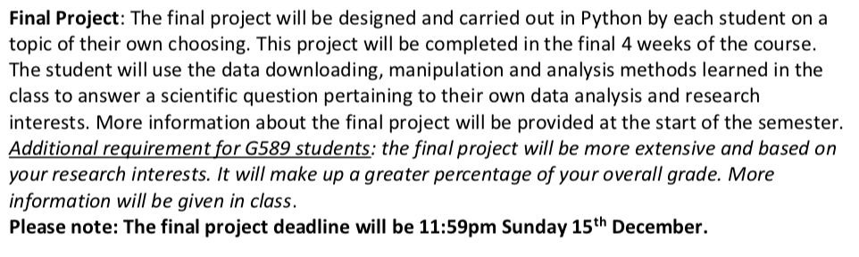
Grading and final project

Slide 8
Brief Introduction to Jupyter Notebook
Here are two YouTube videos that will give you an introduction to Jupyter Notebook – the application we’ll be using to write our Python scripts:
https://www.youtube.com/watch?v=jZ952vChhuI
https://www.youtube.com/watch?v=HW29067qVWk
You don’t need to watch all of these videos, especially the longer one, but it would be helpful to watch the first one to give you an idea before our first class on Setember 4th. However, we will go through how we use Jupyter Notebooks in the first class, so don’t worry if none of this makes sense to you.

Slide 9
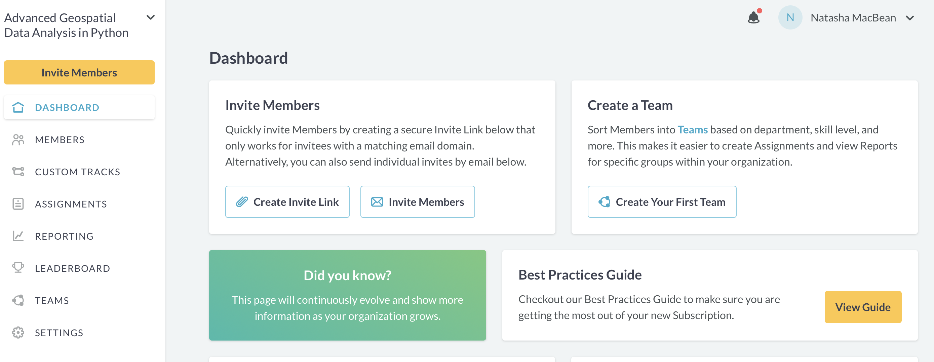
DataCamp.com
Note #1: We have a private ”Academic Classroom” on DataCamp.com from which tutorials may occasionally be assigned for homework to introduce you to a particular Python programming topic – but they will not be part of your grade.
Note #2: As part of the DataCamp ”Academic Classroom” you have free access to all of DataCamp’s tutorials for the next 6 months – so make good use of it for extra learning!

Slide 10
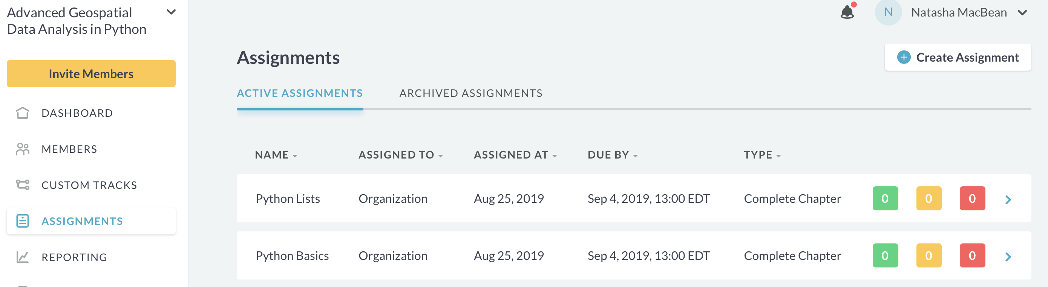
In-class Exercise Week 1
This week I have set the first two Python tutorials for you to do during class (though you do not need to come to the classroom in SB 221).
You do not have to do these tutorials, but if you are new to Python I strongly suggest you do them to start learning the basics.

Slide 11
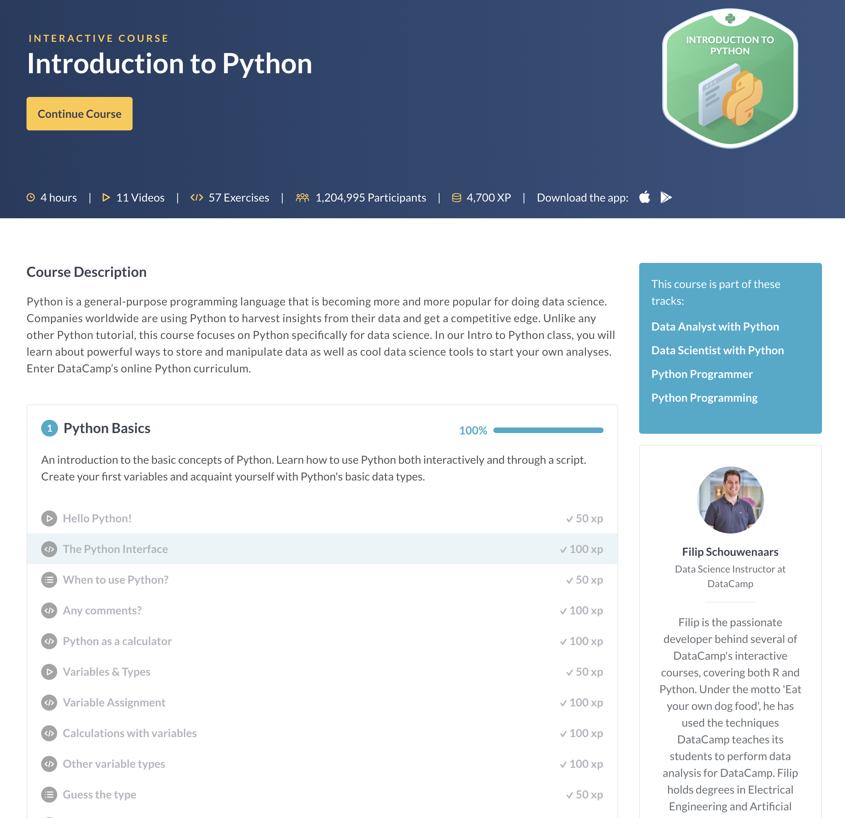
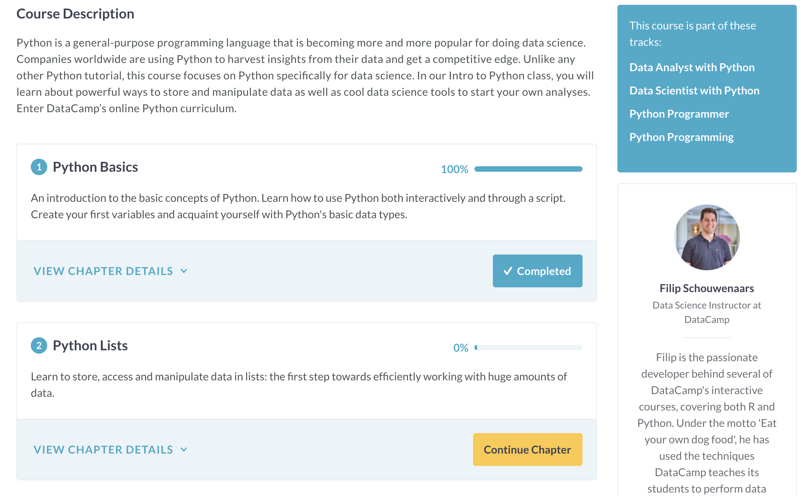
In-class exercises Week 1: DataCamp.com tutorials to introduce you to the basics (or refresh your memory!)

Slide 12
In-class exercises Week 1: DataCamp.com tutorials to introduce you to the basics (or refresh your memory!)

Slide 13
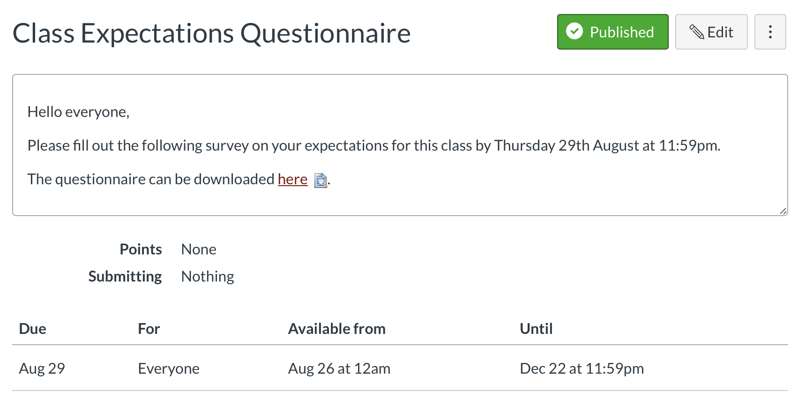
Class Expectations Questionnaire

Slide 14
1st Week assignments: Python Basics, Python Lists and Course Expectations Questionnaire
Go to the Canvas course page and 1st the Modules Page to see the assignments/In-class exercises for Week 1

